Slide 1
Product Classifier using Embedded Systems and Machine Learning
By
Hamza Sunasra 1613110
Trivikram Umanath 1613125
Rahul Singh 1613127

Slide 2
Introduction
Implementing a similar Learning Algorithm for classifying products, rather than having their barcodes scanned
The dataset consisted of labeled images that were used to get the predicted values
Building a bot capable of picking and dropping items
Capturing image, and process as per the model to yield a prediction
Based on this prediction, directing the bot to a desired drop/ pickup location and perform the required action
Notes:
This project attempts at implementing a similar Learning Algorithm for classifying products. Over here, we train a model using images of products, that were captured using cameras, all set at different angles. The dataset consisted of labeled images that were used to get the predicted values. This dataset is trained using CNN and hence, our model is prepared. This model can then be exported to various devices, where the only thing required would be to capture images. The captured images can be processed to suit the specifications of the trained model. This preprocessed image would be fed to the model, which would classify the image as per its history of data.

Slide 3
Project Objective
Why this Project?
The previously used methods for categorizing products used barcode readers since information regarding the products can be retrieved by scanning a given code.
It has its own drawbacks and tradeoffs.
The advantages of using these ML Algorithms is that they take into account the finer details or aspects of images to be classified.
Learning Algorithms can swiftly recognize products not based on a code, but the actual live product.
Making the actions of picking and dropping items automated
Notes:
It eliminates the involvement of humans and hence, also drastically reduces the scope of human errors. It is a pretty reliable technique which is too efficient, to not be used.
No modifications of the products is possible using the barcode. It also requires for the code to be scanned perfectly, with it lying perfectly in the line of sight. Production and time to time updation of the products in the database of the barcode system for it to be recognised is also a tedious work. Since barcode scanning is vulnerable to forgery and theft, a real life analysis of the product is more suitable in such scenarios.
The more layers we keep on adding, the better the system gets for distinguishing characteristics.

Slide 4
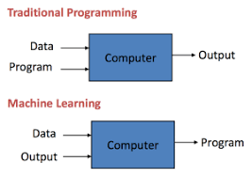
What is Machine Learning?
Tom Mitchell(1997):The field of machine learning is concerned with the question of how to construct computer programs that automatically improve with experience.
Machine learning focuses on the development of computer programs that can access data and use it to learn for themselves.
In Layman's term Machine Learning is Data+Output=Rules while traditional Computer science is Data+Rules=Output.

Slide 5
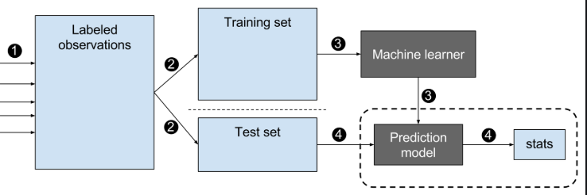
Data Operations
In any Machine Learning project there are two stages to it.
1)Training:
2)Validation(Testing):
Both the above operations are carried out for the dataset where the value of the input and output is both known.
Notes:
Training in layman’s term is mapping the input features and calculating the probabilities.For eg

Slide 6
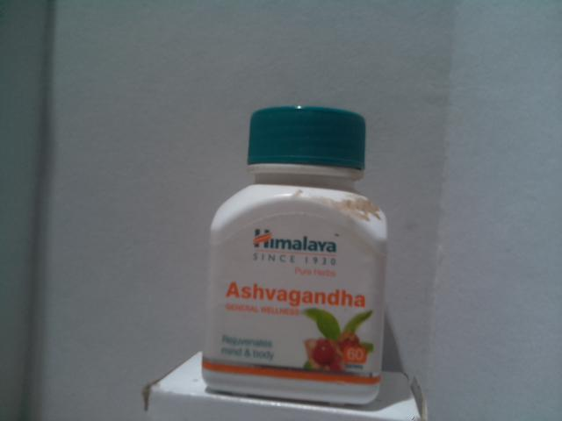
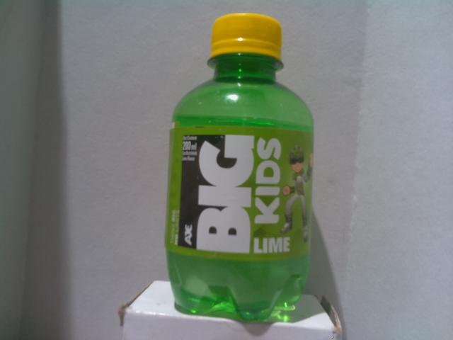
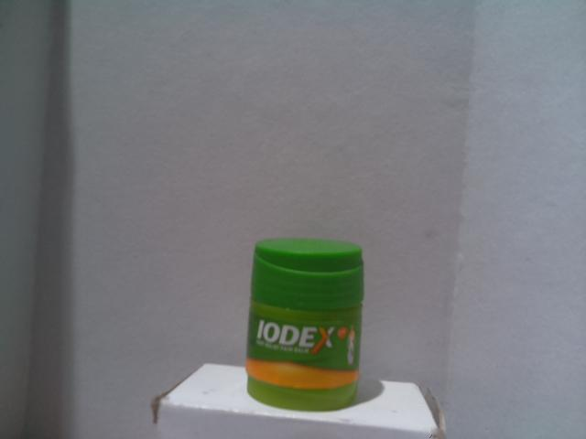
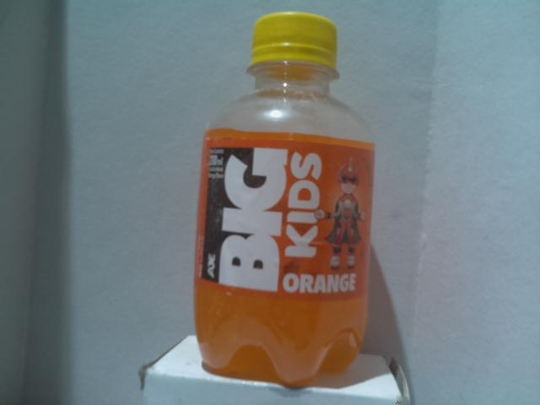
Dataset Curation
Placing the Product in front of the Pi with a white constant background
Using Pi Camera interface with Pi to program the Pi
Setting the resolution of the camera to 640x480, framerate to 80 and construct an iterator to capture a 1000 images of the same Product
Running the custom made Program to click the images and curate our dataset
Replacing the Product with another Product and repeating the above steps

Slide 7
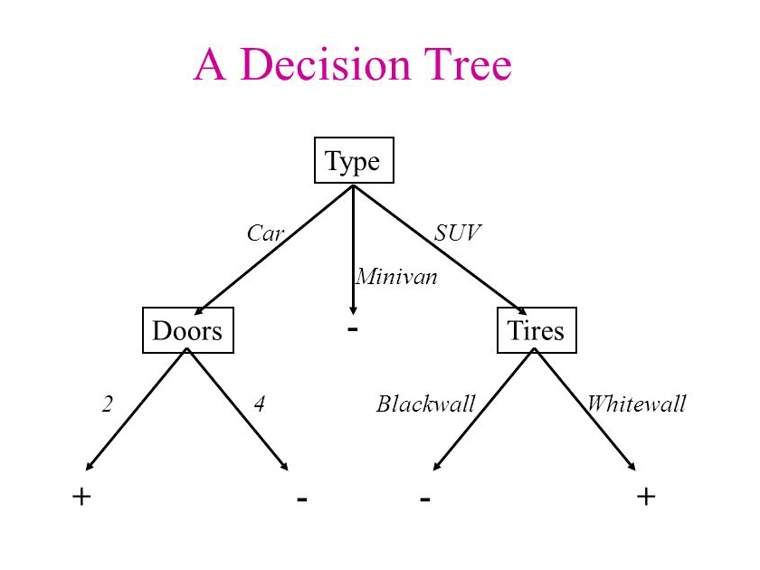
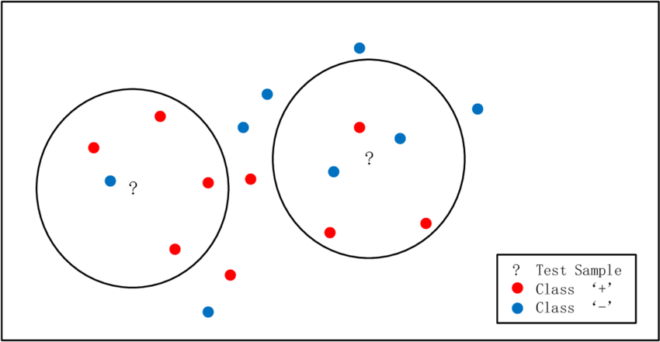
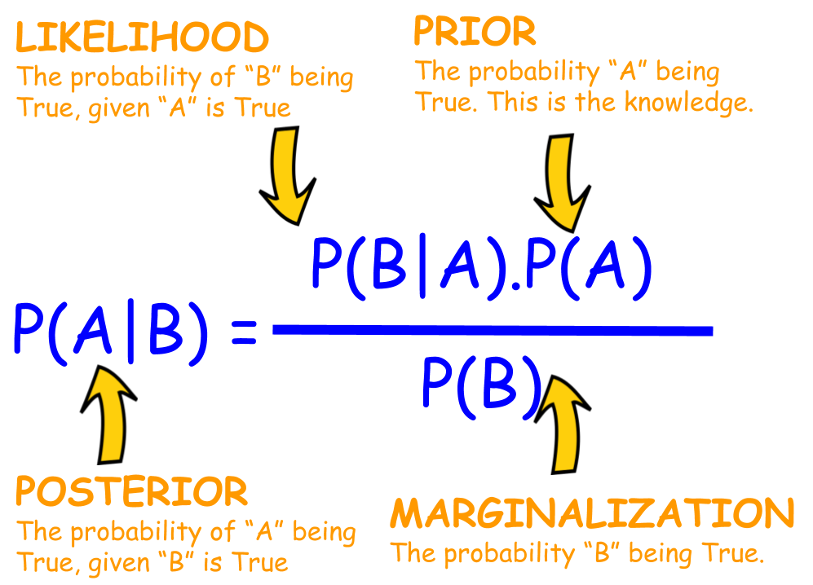
Deciding ML Algorithms
Machine Learning Algorithms considered:
1)Naive Bayes
2)K-Nearest Neighbour
3)Decision Tree
4)Random Forest
5)Voting Classifiers

Slide 8

What is a Neural Networks?
A neural network is composed of 3 types of layers:
Input layer — It is used to pass in our input which could be an image, text or any suitable type of data for NN.
Hidden Layer — These are the layers in between the input and output layers. These layers are responsible for learning the mapping between input and output. and it does this through a series of matrix multiplications and mathematical transformations .
Output Layer — This layer is responsible for giving us the output of the NN given our inputs.

Slide 9
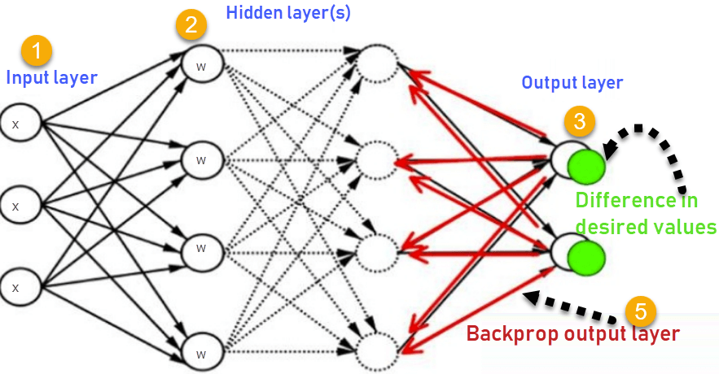
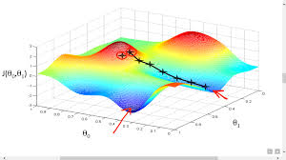
The goal of Neural Networks
The basic idea behind Neural Networks is to find the weights of synapses connecting neurons from one layer to another.
If all the input features are mapped right over some iterations these weights carry the respective information to effectively predict.
The updation of weights is done using BackPropagation Algorithm
The goal is to reach the global minimum of the gradient shown in the diagram.
Reaching this global minimum is called as convergence of neural networks.

Slide 10
Image Preprocessing
There are a number of pre-processing steps we might wish to carry out before using this in any Deep Learning project.
Image ReScaling: 640x480 to 64x64
Normalizing image inputs: 0-225 to 0-1
Data augmentation: Shearness,Zoom,Flip
Notes:
Uniform aspect ratio: One of the first steps is to ensure that the images have the same size and aspect ratio. Most of the neural network models assume a square shape input image, which means that each image needs to be checked if it is a square or not, and cropped appropriately.
Image Scaling: Once we’ve ensured that all images are square (or have some predetermined aspect ratio), it’s time to scale each image appropriately.
Normalizing image inputs: Data normalization is an important step which ensures that each input parameter (pixel, in this case) has a similar data distribution. This makes convergence faster while training the network. Data normalization is done by subtracting the mean from each pixel and then dividing the result by the standard deviation.
Data augmentation: Another common pre-processing technique involves augmenting the existing data-set with perturbed versions of the existing images. Scaling, rotations and other affine transformations are typical. This is done to expose the neural network to a wide variety of variations. This makes it less likely that the neural network recognizes unwanted characteristics in the data-set.

Slide 11
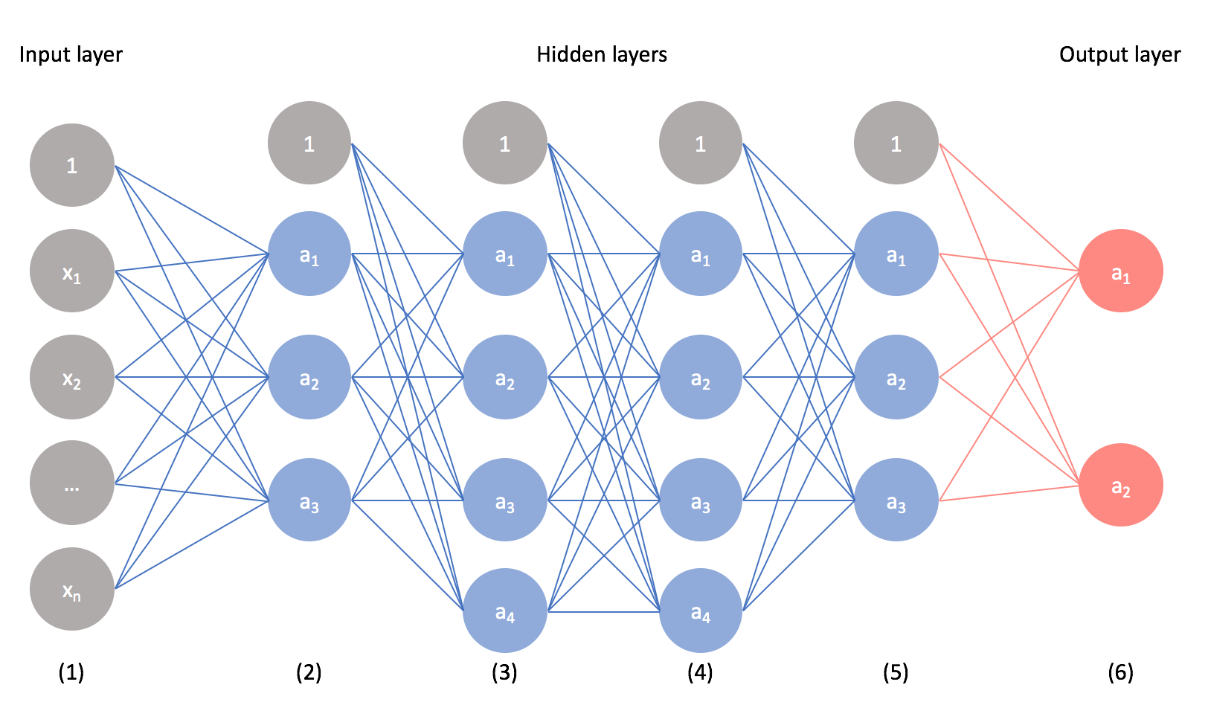
Convolution Neural Networks
A Convolutional Neural Network (ConvNet/CNN) is a Deep Learning algorithm which can take in an input image, assign importance (learnable weights and biases) to various aspects/objects in the image and be able to differentiate one from the other.
The pre-processing required in a ConvNet is much lower as compared to other classification algorithms. ConvNets have the ability to learn these filters/characteristics.
The role of ConvNet is to reduce the images into a form which is easier to process,without losing features which are critical for getting a good prediction.

Slide 12

Layers of CNN
The layers of CNN are:
Convolution Layer
Pooling Layer
Fully Connected layer

Slide 13
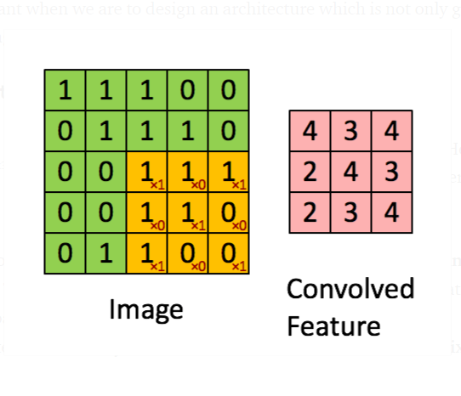
Convolution layer
The convolutional layer is always the first step in a CNN.
We have an input image, a feature detector, and a feature map.
We take the filter and apply it pixel block by pixel block to the input image where the multiplication of the matrices are carried out.
The convolved features of the same dimensions as input are obtained by same padding,whereas of reduced size are obtained by valid padding.
Convolution of an image and obtaining the features

Slide 14
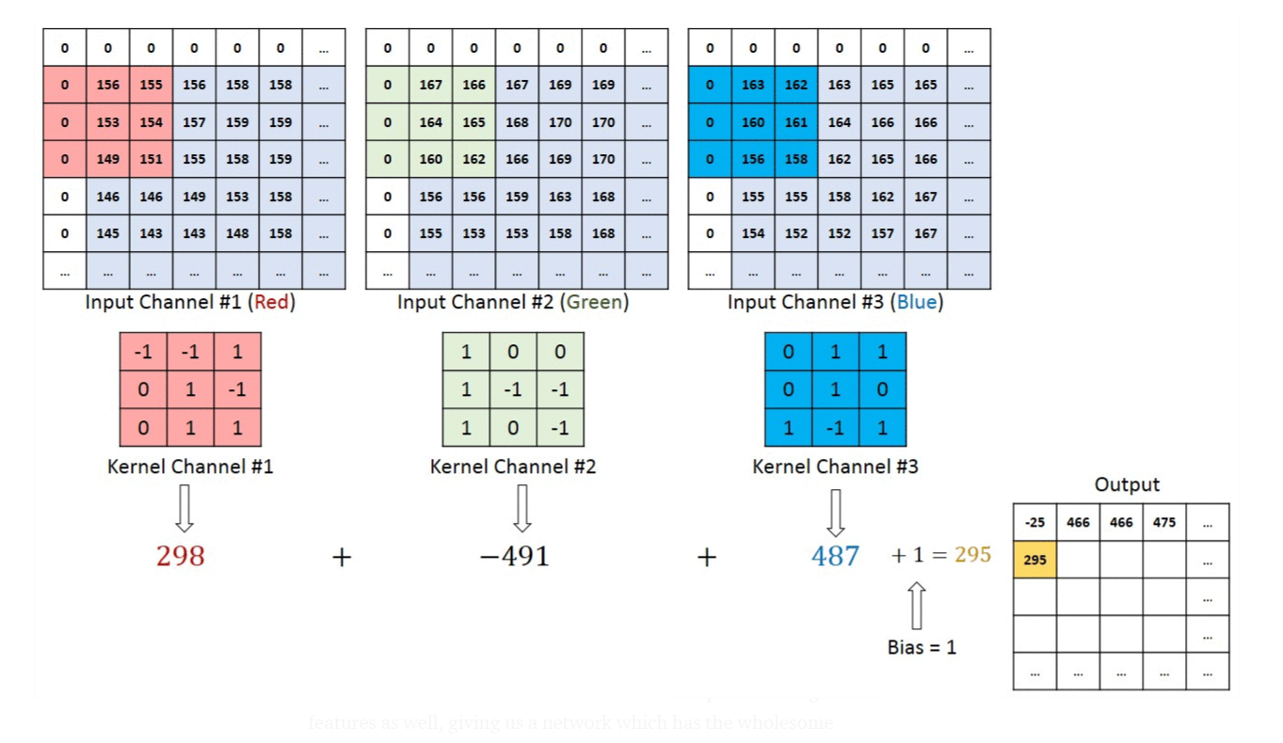
Convolution of R,G,B and obtaining the resultant

Slide 15

Pooling Layer
Pooling layer is used to reduce the size of the data being transferred over to the next layer.
Pooling is nothing but using a mask of a constant size and taking either the average or max of the underlying values.
Used to extract dominant features.

Slide 16
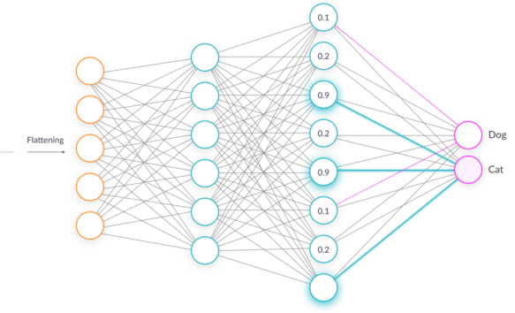
Fully Connected Layer (FC Layer)
The Fully-Connected layer is learning a possibly non-linear function in that space.
Now that we have converted our input image into a suitable form for our Multi-Level Perceptron, we shall flatten the image into a column vector.
The flattened output is fed to a feed-forward neural network and backpropagation applied to every iteration of training. Over a series of epochs, the model is able to distinguish between dominating and certain low-level features in images and classify them using the Softmax Classification technique.

Slide 17
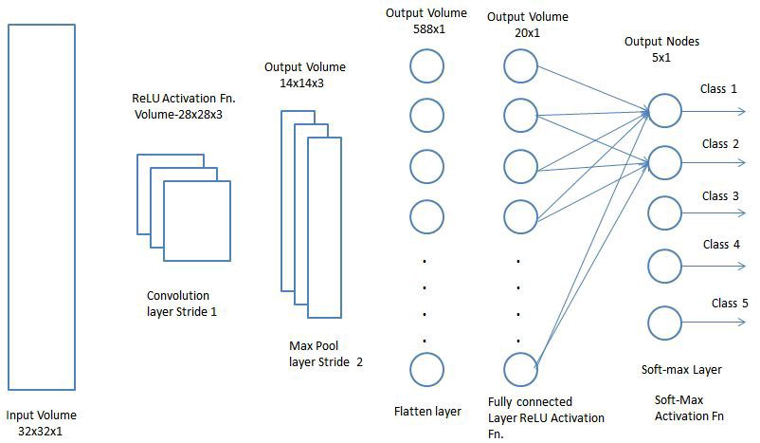
Fully Connected Layer (FC Layer)

Slide 18
Components
No. | Components | Quantity | Price (in Rs.)
1 | Raspberry Pi Model 3B+ | 1 | 1*2500=2500
2 | Raspberry Pi Camera | 1 | 1*300=300
3 | Chassis & Claw | 1 | 1*100=100
4 | DC Motors | 4 | 4*75=300
5 | Servo Motor | 1 | 1*60=60
6 | IR Sensor Module | 3 | 3*30=90
7 | Motor Driver IC | 2 | 2*25=50
8 | 12 V Battery | 1 | 1*600=600
9 | Bread Board | 1 | 1*50=50
10 | Wires |  | 100
 | Total Price |  | 4150 /-

Slide 19
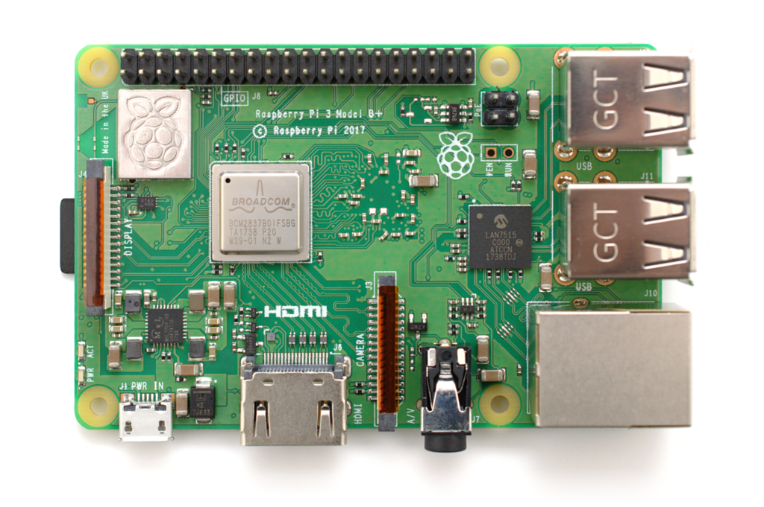
Raspberry Pi Model 3B+
A single board computer
Product of Raspberry-pi foundation
Runs wide range of OS
Huge range of sensors and drivers available which makes it choice for IoT
Low power boards are available
Comes with built-in Wi-Fi and Bluetooth functions

Slide 20
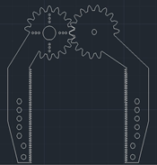
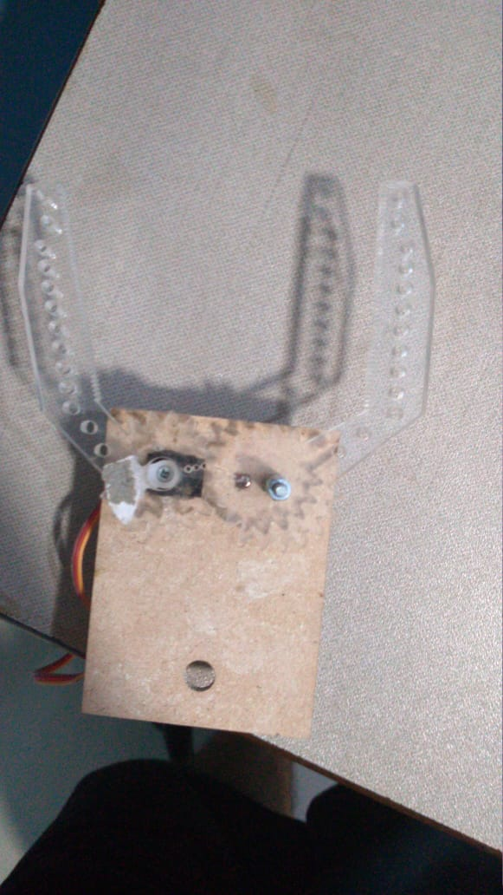
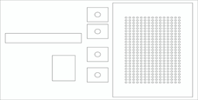
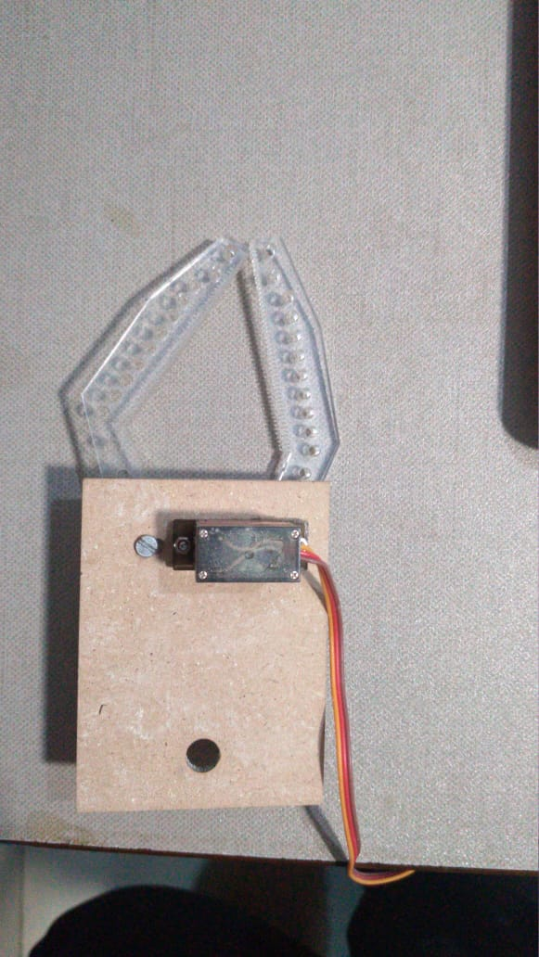
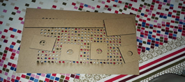
Chassis and Claw
Fig: Design of Chassis
Fig: Design of Arm

Slide 21
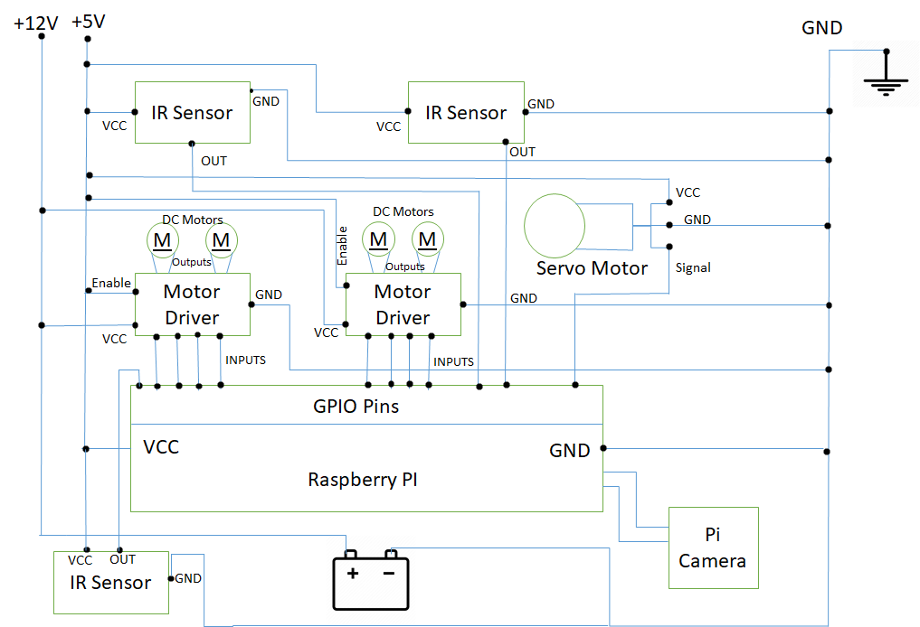
Connections

Slide 22
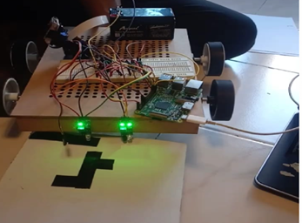
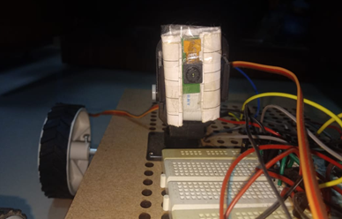
Connections
Fig: Robotic Car
Fig: Connection of Pi Camera to Raspberry Pi

Slide 23
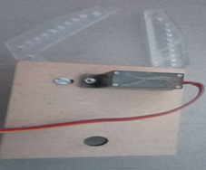
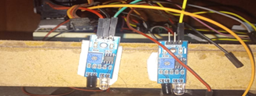
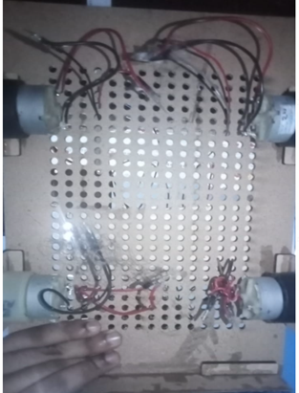
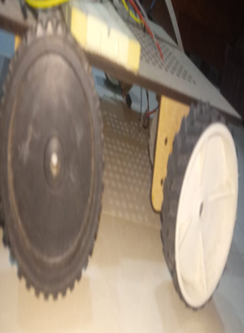
Fig. Connection of IR Sensors to Raspberry Pi
Fig. Connection of Servo Motor to Arm
Fig. Attachment of DC Motors to Wheels
Fig. Connection of DC Motors to Circuit

Slide 24
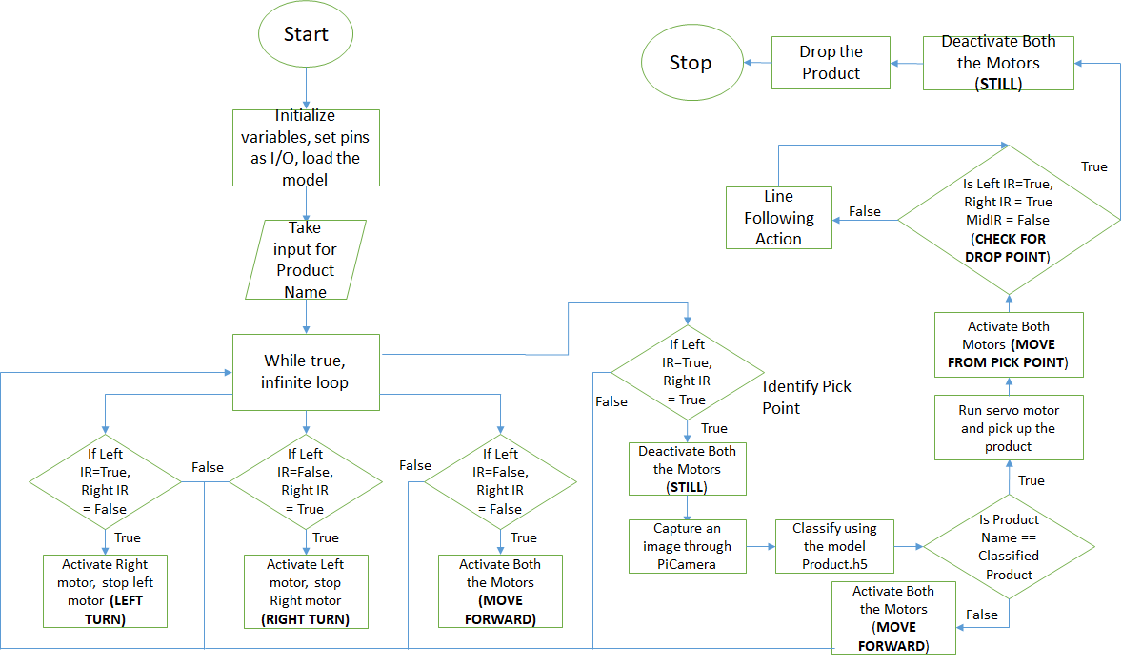
Flowchart

Slide 25
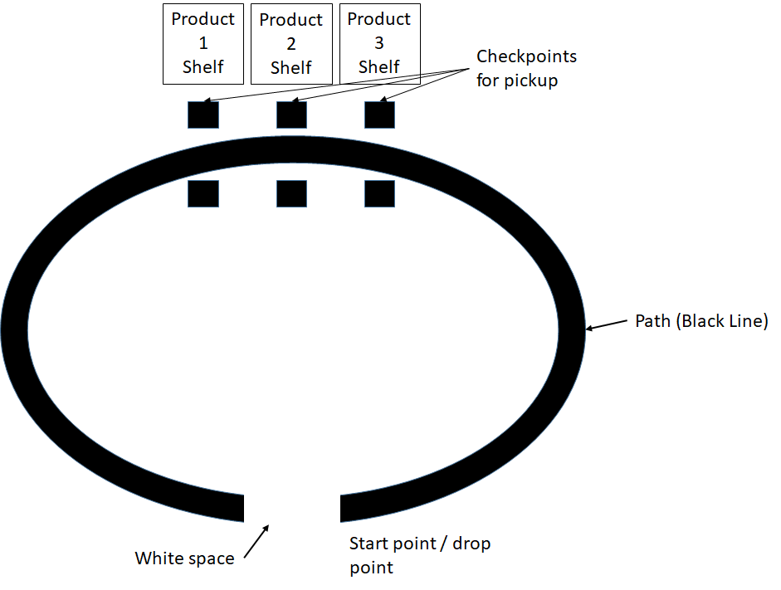

Proposed Track
Direction of Bot

Slide 26
Predicting the Product
An image is captured using Picamera, capture and is saved in the test folder
Load the model and use that model to predict the Products name
Prediction function of a CNN model returns a confidence array where for each and every product there is a confidence associated with it
Deciding on the product only when the maximum value of the confidence array passes a certain threshold

Slide 27
Line Following Bot
Detect the presence of a line and follow it by using two sets of IR sensors ( with the line in between), and a primary black line (path)
The black lines absorb the light and once detected by IR sensors, the module returns a high signal
When the path (black line) takes a turn on either side, the IR sensor (in whose direction the turn has been taken) is alerted, and sends a signal back to the controller
The set of motors associated with that IR halt, while the other one goes on running
Thus, a turn is made till the IR passes the black line, and is met with a proper reflecting surface again

Slide 28
Pick and Drop Action
To grab the objects, and safely drop it at the desired location without letting go of it
One of the arms has the rotating shaft of the servo motor attached to its end
The arms are placed so that the movement of one arm, forces the other to move in the opposite direction due to the interlocked teeth of both the gears
When the motor rotates anti-clockwise, the arms close in on the object and grab it
The time for which the motor suns decides how far the arms will close in

Slide 29
Conclusion
After working on this Project we have come to the conclusion that the most seamless and efficient algorithm to classify images is CNN of keras Library.
Keras has additional classes especially for image augmentation and preprocessing which counterbalances drawbacks of a smaller dataset.
Line Following System could be used in Departmental Stores or Shopping Markets for picking and dropping Products.

Slide 30
Thank You!

